Slide 1
18AIC302J Web programming for Artificial Intelligence UNIT-4 Django

Slide 2
Topics
Django -MVC: Web Frameworks
Python Django-Introduction
MVC Architecture
Environment Setup – Project Structure
Building Block Django
Example Django Project
Building HTTP APIs With Django
Databases using Django

Slide 3
What is Django?
Django is a Python framework that makes it easier to create web sites using Python.
Django takes care of the difficult stuff so that you can concentrate on building your web applications.
Django emphasizes reusability of components, also referred to as DRY (Don't Repeat Yourself), and comes with ready-to-use features like login system, database connection and CRUD operations (Create Read Update Delete).

Slide 4
How does Django Work?
Django follows the MVT design pattern (Model View Template).
Model - The data you want to present, usually data from a database.
View - A request handler that returns the relevant template and content - based on the request from the user.
Template - A text file (like an HTML file) containing the layout of the web page, with logic on how to display the data.

Slide 5
Model
The model provides data from the database.
In Django, the data is delivered as an Object Relational Mapping (ORM), which is a technique designed to make it easier to work with databases.
The most common way to extract data from a database is SQL. One problem with SQL is that you have to have a pretty good understanding of the database structure to be able to work with it.
Django, with ORM, makes it easier to communicate with the database, without having to write complex SQL statements.
The models are usually located in a file called models.py

Slide 6
View
A view is a function or method that takes http requests as arguments, imports the relevant model(s), and finds out what data to send to the template, and returns the final result.
The views are usually located in a file called views.py

Slide 7
Template
A template is a file where you describe how the result should be represented.
Templates are often .html files, with HTML code describing the layout of a web page, but it can also be in other file formats to present other results, but we will concentrate on .html files.
Django uses standard HTML to describe the layout, but uses Django tags to add logic:
<h1>My Homepage</h1>
<p>My name is {{ firstname }}.</p>
The templates of an application is located in a folder named templates

Slide 8
Model View Controller (MVC)
It is a software design pattern that is used to implement user interfaces and gives emphasis on separating data representation from the components which interact and process the data.
It has 3 components and each component has a specific purpose:
This Model is the central component of this architecture and manages the data, logic as well as other constraints of the application.
The View deals with how the data will be displayed to the user and provides various data representation components.
The Controller manipulates the Model and renders the view by acting as a bridge between both of them.

Slide 9
MVC was created by Trygve Reenskaug. The main goal of this design pattern was to solve the problem of users controlling a large and complex data set by splitting a large application into specific sections that all have their own purpose.
Features of MVC :
It provides a clear separation of business logic, UI logic, and input logic.
It offers full control over your HTML and URLs which makes it easy to design web application architecture.
It is a powerful URL-mapping component using which we can build applications that have comprehensible and searchable URLs.
It supports Test Driven Development (TDD).

Slide 10
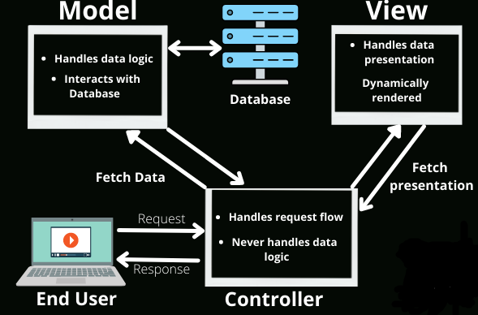

Slide 11
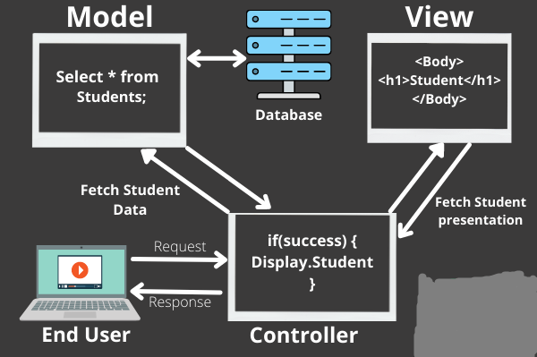

Slide 12
Model View Template (MVT)
This is yet another design pattern similar to MVC. It is also used for implementing web interfaces and applications but in contrast to MVC, the controller part is taken care for us by the framework itself.
This Model similar to MVC acts as an interface for your data and is basically the logical structure behind the entire web application which is represented by a database such as MySql, PostgreSQL.
The View executes the business logic and interacts with the Model and renders the template. It accepts HTTP request and then return HTTP responses.
The Template is the component which makes MVT different from MVC. Templates act as the presentation layer and are basically the HTML code that renders the data. The content in these files can be either static or dynamic.

Slide 13
Difference between MVC and MVT design patterns
S.NO. | Model View Controller (MVC) | Model View Template (MVT)
1. | MVC has controller that drives both Model and View. | MVT has Views for receiving HTTP request and returning HTTP response.
2. | View tells how the user data will be presented. | Templates are used in MVT for that purpose.
3. | In MVC, we have to write all the control specific code. | Controller part is managed by the framework itself.
4. | Highly coupled | Loosely coupled
5. | Modifications are difficult | Modifications are easy
6. | Suitable for development of large applications but not for small applications. | Suitable both small and large applications.
7. | Flow is clearly defined thus easy to understand. | Flow is sometimes harder to understand as compared to MVC.
8. | It doesn’t involve mapping of URLs. | URL pattern mapping takes place.
9. | Examples are ASP.NET MVC, Spring MVC etc. | Django uses MVT pattern.

Slide 14
So, What is Going On?
When you have installed Django and created your first Django web application, and the browser requests the URL, this is basically what happens:
Django receives the URL, checks the urls.py file, and calls the view that matches the URL.
The view, located in views.py, checks for relevant models.
The models are imported from the models.py file.
The view then sends the data to a specified template in the template folder.
The template contains HTML and Django tags, and with the data it returns finished HTML content back to the browser.

Slide 15
Django History
Django was invented by Lawrence Journal-World in 2003, to meet the short deadlines in the newspaper and at the same time meeting the demands of experienced web developers.
Initial release to the public was in July 2005.
Latest version of Django is 4.0.3 (March 2022).

Slide 16
URLs
Django also provides a way to navigate around the different pages in a website.
When a user requests a URL, Django decides which view it will send it to.
This is done in a file called urls.py

Slide 17
Django Framework
Django Requires Python
To check if your system has Python installed, run this command in the command prompt:
python –version
If Python is installed, you will get a result with the version number, like this
Python 3.9.2
If you find that you do not have Python installed on your computer, then you can download it for free from the following website:
https://www.python.org/

Slide 18
PIP
To install Django, you must use a package manager like PIP, which is included in Python from version 3.4.
To check if your system has PIP installed, run this command in the command prompt:
pip --version
If PIP is installed, you will get a result with the version number.
on a windows machine, the result looks like this:
pip 20.2.3 from c:\python39\lib\site-packages\pip (python 3.9)
If you do not have PIP installed, you can download and install it from this page: https://pypi.org/project/pip/

Slide 19
Django - Create Virtual Environment

Slide 20
Virtual Environment
Each Django project, and one way to manage a virtual environment is venv, which is included in Python.
The name of the virtual environment is eg myworld.
Type the following in the command prompt, remember to navigate to where you want to create your project:
py -m venv myworld

Slide 21
Virtual Environment
This will set up a virtual environment, and create a folder named "myworld" with subfolders and files, like this:
myworld
Include
Lib
Scripts
pyvenv.cfg
Windows:
myworld\Scripts\activate.bat

Slide 22
Virtual Environment
Once the environment is activated, result in the command prompt:
(myworld) C:\Users\Your Name>

Slide 23
Install Django

Slide 24
Install Django
Now, that we have created a virtual environment, we are ready to install Django.
Note: Remember to install Django while you are in the virtual environment!
Django is installed using pip, with this command:
Windows:
(myworld) C:\Users\Your Name>py -m pip install Django

Slide 25
Install Django
Which will give a result that looks like this (at least on my Windows machine):
Collecting Django
Downloading Django-4.0.3-py3-none-any.whl (8.0 MB)
| 8.0 MB 2.2 MB/s
Collecting sqlparse>=0.2.2
Using cached sqlparse-0.4.2-py3-none-any.whl (42 kB)
Collecting asgiref<4,>=3.4.1
Downloading asgiref-3.5.0-py3-none-any.whl (22 kB)
Collecting tzdata; sys_platform == "win32"
Downloading tzdata-2021.5-py2.py3-none-any.whl (339 kB)| 339 kB 6.4 MB/s
Installing collected packages: sqlparse, asgiref, tzdata, Django
Successfully installed Django-4.0.3 asgiref-3.5.0 sqlparse-0.4.2 tzdata-2021.5
WARNING: You are using pip version 20.2.3; however, version 22.3 is available.
You should consider upgrading via the 'C:\Users\Your Name\myworld\Scripts\python.exe -m pip install --upgrade pip' command.
That's it! Now you have installed Django in your new project, running in a virtual environment!

Slide 26
Check Django Version
You can check if Django is installed by asking for its version number like this:
(myworld) C:\Users\Your Name>django-admin --version
If Django is installed, you will get a result with the version number:
4.1.2

Slide 27
Django Create Project

Slide 28
My First Project
Once you have come up with a suitable name for your Django project,
Example: my_tennis_club, navigate to where in the file system you want to store the code (in the virtual environment),
navigate to the myworld folder, and run this command in the command prompt:

Slide 29
django-admin startproject my_tennis_club
Django creates a my_tennis_club folder on computer, with this content:
my_tennis_club
manage.py
my_tennis_club/
__init__.py
asgi.py
settings.py
urls.py
wsgi.py
These are all files and folders with a specific meaning, you can start building applications in it.

Slide 30
Run the Django Project

Slide 31
Now that you have a Django project, you can run it, and see what it looks like in a browser.
Navigate to the /my_tennis_club folder and execute this command in the command prompt:
py manage.py runserver
Which will produce this result:
Watching for file changes with StatReloader
Performing system checks...
System check identified no issues (0 silenced).
You have 18 unapplied migration(s). Your project may not work properly until you apply the migrations for app(s): admin, auth, contenttypes, sessions.
Run 'python manage.py migrate' to apply them.
October 27, 2022 - 13:03:14
Django version 4.1.2, using settings 'my_tennis_club.settings'
Starting development server at http://127.0.0.1:8000/
Quit the server with CTRL-BREAK.
Open a new browser window and type 127.0.0.1:8000 in the address bar.

Slide 32
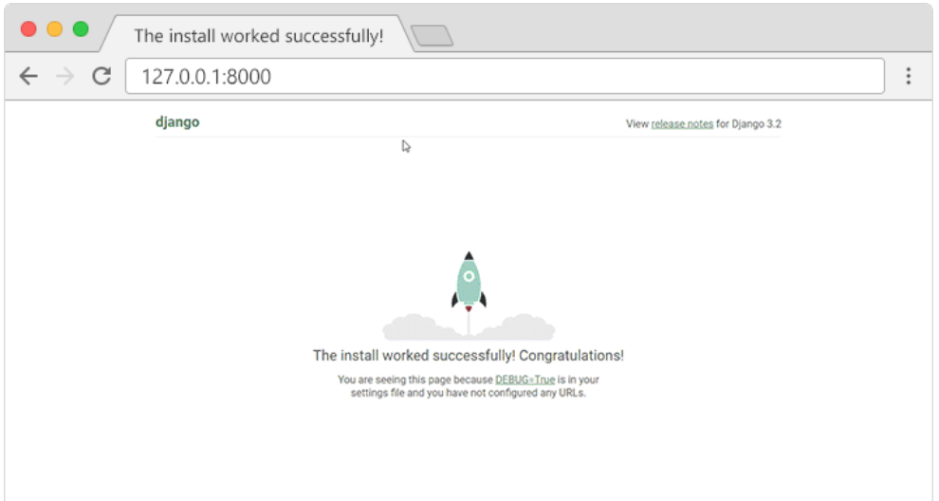
Open a new browser window and type 127.0.0.1:8000 in the address bar. The result:

Slide 33
Django Create App

Slide 34
What is an App?
An app is a web application that has a specific meaning in your project, like a home page, a contact form, or a members database.
create an app that allows us to list and register members in a database.
But first, let's just create a simple Django app that displays "Hello World!".

Slide 35
Create App
I will name my app members.
Start by navigating to the selected location where you want to store the app, in my case the my_tennis_club folder, and run the command below.
If the server is still running, and you are not able to write commands, press [CTRL] [BREAK], or [CTRL] [C] to stop the server and you should be back in the virtual environment.
py manage.py startapp members

Slide 36
Django creates a folder named members in my project, with this content:
my_tennis_club
manage.py
my_tennis_club/
members/
migrations/
__init__.py
__init__.py
admin.py
apps.py
models.py
tests.py
views.py
These are all files and folders with a specific meaning.

Slide 37
views.py.
First, take a look at the file called views.py.
This is where we gather the information we need to send back a proper response.

Slide 38
Django Views
Views
Django views are Python functions that takes http requests and returns http response, like HTML documents.
A web page that uses Django is full of views with different tasks and missions.
Views are usually put in a file called views.py located on your app's folder.
There is a views.py in your members folder that looks like this:
my_tennis_club/members/views.py:
from django.shortcuts import render
# Create your views here.

Slide 39
Django Views
Find it and open it, and replace the content with this:
my_tennis_club/members/views.py:
from django.shortcuts import render
from django.http import HttpResponse
def members(request):
return HttpResponse("Hello world!")
This is a simple example on how to send a response back to the browser.
But how can we execute the view? Well, we must call the view via a URL.

Slide 40
Django URLs
URLs
Create a file named urls.py in the same folder as the views.py file, and type this code in it:
my_tennis_club/members/urls.py:
from django.urls import path
from . import views
urlpatterns = [
path('members/', views.members, name='members'),
]

Slide 41
Django URLs
The urls.py file you just created is specific for the members application. We have to do some routing in the root directory my_tennis_club as well. This may seem complicated, but for now, just follow the instructions below.
There is a file called urls.py on the my_tennis_club folder, open that file and add the include module in the import statement, and also add a path() function in the urlpatterns[] list, with arguments that will route users that comes in via 127.0.0.1:8000/.

Slide 42
Django URLs
Then your file will look like this:
my_tennis_club/my_tennis_club/urls.py:
from django.contrib import admin
from django.urls import include, path
urlpatterns = [
path('', include('members.urls')),
path('admin/', admin.site.urls),
]

Slide 43
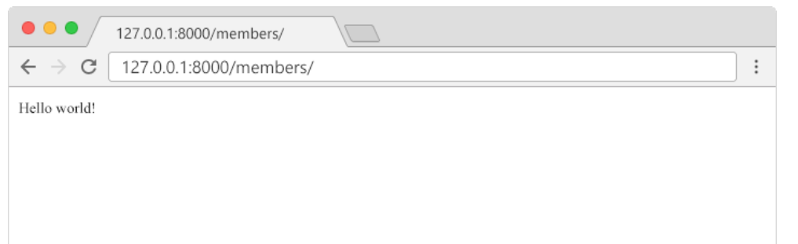
Django URLs
If the server is not running, navigate to the /my_tennis_club folder and execute this command in the command prompt:
py manage.py runserver
In the browser window, type 127.0.0.1:8000/members/ in the address bar.

Slide 44
Django Templates
Templates
Create a templates folder inside the members folder, and create a HTML file named myfirst.html.
The file structure should be like this:
my_tennis_club
manage.py
my_tennis_club/
members/
templates/
myfirst.html

Slide 45
Django Templates
Open the HTML file and insert the following:
my_tennis_club/members/templates/myfirst.html:
<!DOCTYPE html>
<html>
<body>
<h1>Hello World!</h1>
<p>Welcome to my first Django project!</p>
</body>
</html>

Slide 46
Change Settings
To be able to work with more complicated stuff than "Hello World!", We have to tell Django that a new app is created.
This is done in the settings.py file in the my_tennis_club folder.
Look up the INSTALLED_APPS[] list and add the members app like this:
my_tennis_club/my_tennis_club/settings.py:
INSTALLED_APPS = [
'django.contrib.admin',
'django.contrib.auth',
'django.contrib.contenttypes',
'django.contrib.sessions',
'django.contrib.messages',
'django.contrib.staticfiles',
'members'
]

Slide 47
Change Settings
Then run this command:
py manage.py migrate
Which will produce this output:
Operations to perform:
Apply all migrations: admin, auth, contenttypes, sessions
Running migrations:
Applying contenttypes.0001_initial... OK
Applying auth.0001_initial... OK
Applying admin.0001_initial... OK
Applying admin.0002_logentry_remove_auto_add... OK
Applying admin.0003_logentry_add_action_flag_choices... OK
Applying contenttypes.0002_remove_content_type_name... OK
Applying auth.0002_alter_permission_name_max_length... OK
Applying auth.0003_alter_user_email_max_length... OK
Applying auth.0004_alter_user_username_opts... OK
Applying auth.0005_alter_user_last_login_null... OK
Applying auth.0006_require_contenttypes_0002... OK
Applying auth.0007_alter_validators_add_error_messages... OK
Applying auth.0008_alter_user_username_max_length... OK
Applying auth.0009_alter_user_last_name_max_length... OK
Applying auth.0010_alter_group_name_max_length... OK
Applying auth.0011_update_proxy_permissions... OK
Applying auth.0012_alter_user_first_name_max_length... OK
Applying sessions.0001_initial... OK
(myworld) C:\Users\Your Name\myworld\my_tennis_club>

Slide 48
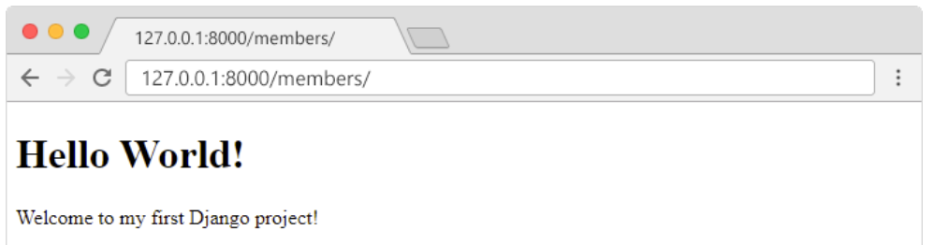
Start the server by navigating to the /my_tennis_club folder and execute this command:
py manage.py runserver
In the browser window, type 127.0.0.1:8000/members/ in the address bar.
The result should look like this:

Slide 49
Databases using Django

Slide 50
Django Models

Slide 51
Django Models
A Django model is a table in your database.
Django Models
Up until now in this tutorial, output has been static data from Python or HTML templates.
Now we will see how Django allows us to work with data, without having to change or upload files in the prosess.
In Django, data is created in objects, called Models, and is actually tables in a database.

Slide 52
MODEL FIELDS
Fields are organized into records, which contain all the information within the table relevant to a specific entity.
There are concepts to know before creating fields:
Field Type
Field Options
Relationship

Slide 53
1. FIELD TYPE
The fields defined inside the Model class are the columns name of the mapped table
E.g.
AutoField() BooleanField() CharField()
An integer field that automatically increments
Store true/false value and generally used for checkboxes
A string field for small to large-sized strings.
DateField()
A date field represents python datetime. date instance.
25

Slide 54

2. FIELD OPTIONS
Field option are used to customize and put constraint on the table rows.
E.g.
name= models.CharField(max_length = 60)
here "max_length" specifies the size of the VARCHAR field.

Slide 55
The following are some common and mostly used field option:
01
Null
02
Blank
to store empty values as NULL in database.
if True, the field s allowed to be blank.
05
unique_key
03
default
04
primary_key
puts unique key constraint for column.
store default value for a field
this field will be the primary key for the table

Slide 56
Create Table (Model)
To create a model, navigate to the models.py file in the /members/ folder.
Open it, and add a Member table by creating a Member class, and describe the table fields in it:
my_tennis_club/members/models.py:
from django.db import models
class Member(models.Model):
firstname = models.CharField(max_length=255)
lastname = models.CharField(max_length=255)
The first field, firstname, is a Text field, and will contain the first name of the members.
The second field, lastname, is also a Text field, with the member's last name.
Both firstname and lastname is set up to have a maximum of 255 characters.

Slide 57
Migrate
Now when we have described a Model in the models.py file, we must run a command to actually create the table in the database.
Navigate to the /my_tennis_club/ folder and run this command:
py manage.py makemigrations members
Which will result in this output:
Migrations for 'members':
members\migrations\0001_initial.py
- Create model Member
(myworld) C:\Users\Your Name\myworld\my_tennis_club>

Slide 58
Migrate
Django creates a file describing the changes and stores the file in the /migrations/ folder:
my_tennis_club/members/migrations/0001_initial.py:
# Generated by Django 4.1.2 on 2022-10-27 11:14
from django.db import migrations, models
class Migration(migrations.Migration):
initial = True
dependencies = [
]

Slide 59
Migrate
operations = [
migrations.CreateModel(
name='Member',
fields=[
('id', models.BigAutoField(auto_created=True, primary_key=True, serialize=False, verbose_name='ID')),
('firstname', models.CharField(max_length=255)),
('lastname', models.CharField(max_length=255)),
],
),
]

Slide 60
Migrate
Run the migrate command:
py manage.py migrate
Which will result in this output:
Operations to perform:
Apply all migrations: admin, auth, contenttypes, members, sessions
Running migrations:
Applying members.0001_initial... OK
(myworld) C:\Users\Your Name\myworld\my_tennis_club>
Now you have a Member table in you database!

Slide 61
View SQL
As a side-note: you can view the SQL statement that were executed from the migration above. All you have to do is to run this command, with the migration number:
py manage.py sqlmigrate members 0001
Which will result in this output:
BEGIN;
--
-- Create model Member
--
CREATE TABLE "members_member" ("id" integer NOT NULL PRIMARY KEY AUTOINCREMENT, "firstname" varchar(255) NOT NULL, "lastname" varchar(255) NOT NULL); COMMIT;

Slide 62
Django Insert Data
Add Records
The Members table created in the previous chapter is empty.
We will use the Python interpreter (Python shell) to add some members to it.
To open a Python shell, type this command:
py manage.py shell
Now we are in the shell, the result should be something like this:
Python 3.9.2 (tags/v3.9.2:1a79785, Feb 19 2021, 13:44:55) [MSC v.1928 64 bit (AMD64)] on win32
Type "help", "copyright", "credits" or "license" for more information.
(InteractiveConsole)
>>>

Slide 63
Django Insert Data
At the bottom, after the three >>> write the following:
>>> from members.models import Member
Hit [enter] and write this to look at the empty Member table:
>>> Member.objects.all()
This should give you an empty QuerySet object, like this:
<QuerySet []>
A QuerySet is a collection of data from a database.

Slide 64
Django Insert Data
Add a record to the table, by executing these two lines:
>>> member = Member(firstname='Emil', lastname='Refsnes')
>>> member.save()
Execute this command to see if the Member table got a member:
>>> Member.objects.all().values()
Hopefully, the result will look like this:
<QuerySet [{'id': 1, 'firstname': 'Emil', 'lastname': 'Refsnes'}]>

Slide 65
Add Multiple Records
You can add multiple records by making a list of Member objects, and execute .save() on each entry:
>>> member1 = Member(firstname='Tobias', lastname='Refsnes')
>>> member2 = Member(firstname='Linus', lastname='Refsnes')
>>> member3 = Member(firstname='Lene', lastname='Refsnes')
>>> member4 = Member(firstname='Stale', lastname='Refsnes')
>>> member5 = Member(firstname='Jane', lastname='Doe')
>>> members_list = [member1, member2, member3, member4, member5]
>>> for x in members_list:
>>> x.save()

Slide 66
Add Multiple Records
Now there are 6 members in the Member table:
>>> Member.objects.all().values()
<QuerySet [{'id': 1, 'firstname': 'Emil', 'lastname': 'Refsnes'},
{'id': 2, 'firstname': 'Tobias', 'lastname': 'Refsnes'},
{'id': 3, 'firstname': 'Linus', 'lastname': 'Refsnes'},
{'id': 4, 'firstname': 'Lene', 'lastname': 'Refsnes'},
{'id': 5, 'firstname': 'Stale', 'lastname': 'Refsnes'},
{'id': 6, 'firstname': 'Jane', 'lastname': 'Doe'}]>

Slide 67
Django Update Data
Update Records
To update records that are already in the database, we first have to get the record we want to update:
>>> from members.models import Member
>>> x = Member.objects.all()[4]
x will now represent the member at index 4, which is "Stale Refsnes", but to make sure, let us see if that is correct:
>>> x.firstname
This should give you this result:
'Stale'

Slide 68
Django Update Data
Now we can change the values of this record:
>>> x.firstname = "Stalikken"
>>> x.save()
Execute this command to see if the Member table got updated:
>>> Member.objects.all().values()
Hopefully, the result will look like this:
<QuerySet [{'id': 1, 'firstname': 'Emil', 'lastname': 'Refsnes'},
{'id': 2, 'firstname': 'Tobias', 'lastname': 'Refsnes'},
{'id': 3, 'firstname': 'Linus', 'lastname': 'Refsnes'},
{'id': 4, 'firstname': 'Lene', 'lastname': 'Refsnes'},
{'id': 5, 'firstname': 'Stalikken', 'lastname': 'Refsnes'},
{'id': 6, 'firstname': 'Jane', 'lastname': 'Doe'}]>

Slide 69
Django Delete Data
Delete Records
To delete a record in a table, start by getting the record you want to delete:
>>> from members.models import Member
>>> x = Member.objects.all()[5]
x will now represent the member at index 5, which is "Jane Doe", but to make sure, let us see if that is correct:
>>> x.firstname
This should give you this result:
'Jane'
Now we can delete the record:
>>> x.delete()
The result will be:
(1, {'members.Member': 1})

Slide 70
Django Update Model
Add Fields in the Model
To add a field to a table after it is created, open the models.py file, and make your changes:
my_tennis_club/members/models.py:
from django.db import models
class Member(models.Model):
firstname = models.CharField(max_length=255)
lastname = models.CharField(max_length=255)
phone = models.IntegerField()
joined_date = models.DateField()
As you can see, we want to add phone and joined_date to our Member Model.
This is a change in the Model's structure, and therefor we have to make a migration to tell Django that it has to update the database:
py manage.py makemigrations members

Slide 71
Django Prepare Template

Slide 72
Create Template
After creating Models, with the fields and data we want in them, it is time to display the data in a web page.
Start by creating an HTML file named all_members.html and place it in the /templates/ folder:
my_tennis_club/members/templates/all_members.html:
<!DOCTYPE html>
<html>
<body>
<h1>Members</h1>
<ul>
{% for x in mymembers %}
<li>{{ x.firstname }} {{ x.lastname }}</li>
{% endfor %}
</ul>
</body>
</html>

Slide 73
Modify View
model data available in the template. This is done in the view.
In the view we have to import the Member model, and send it to the template like this:
my_tennis_club/members/views.py:
from django.http import HttpResponse
from django.template import loader
from .models import Member
def members(request):
mymembers = Member.objects.all().values()
template = loader.get_template('all_members.html')
context = {
'mymembers': mymembers,
}
return HttpResponse(template.render(context, request))

Slide 74
Modify View
The members view does the following:
Creates a mymembers object with all the values of the Member model.
Loads the all_members.html template.
Creates an object containing the mymembers object.
Sends the object to the template.
Outputs the HTML that is rendered by the template.

Slide 75
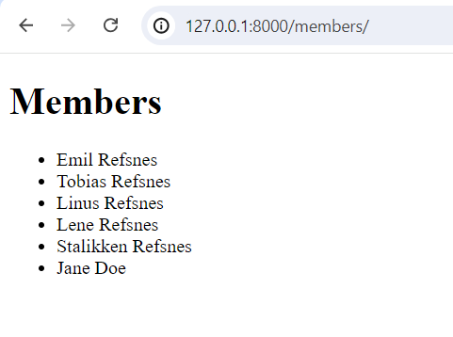
Modify View
Start the server by navigating to the /my_tennis_club/ folder and execute this command:
py manage.py runserver
In the browser window, type 127.0.0.1:8000/members/ in the address bar.

